Slide 1
Lab5
scRNA-seq, classification

Slide 2
Outline
Please remeber to fill the quiz!
Exceptional answer gets exceptional grade.
HW3 released, due March 8th
Good news: No Odyssey
Machine learning with caret package. scRNA analysis with Seurat
Brief recap of supervised learning methods
Seurat hands-on
Additional office hour next week
March 6th Friday 10-11:30am Kresge Cafe
March 8th Saturday 11:00-noon Science Center Clover

Slide 3
Dataset
features: genes
labels: e.g. diagnosis
Train (X)
y
observations: samples
The data type of labels indicates if it is regression (continous) or classification (discrete)
Test
?

Slide 4
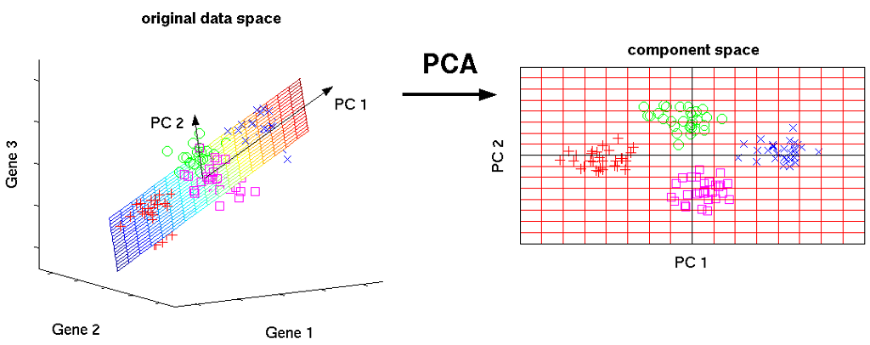
Dimension reduction
why? The “features” for biological dataset is usually genes, which are usually MANY compared to samples. However you may lose interpretebility
Use the reduced projections acquired from training data and apply to the test data
Linear: PCA
Nonlinear: tSNE, UMAP

Slide 5
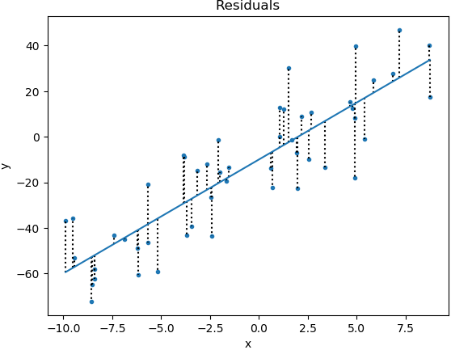
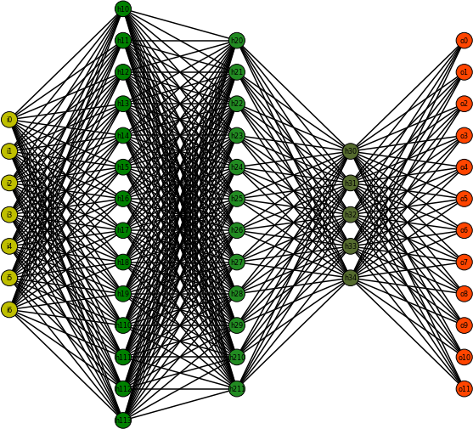
Supervised learning
Supervised learning is where you have input variables (x) and an output variable (Y) and you use an algorithm to learn the mapping function f from the input to the output Y = f(X) .
The goal is to approximate the mapping function so well that when you have new input data (x’) that you can predict the output variables (y’) for that data.
Key: find best f by objective functions (e.g. minimize MSE, maximize likelihood etc)
Beta = argmin(...)

Slide 6
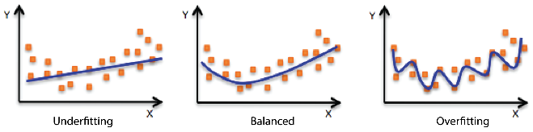
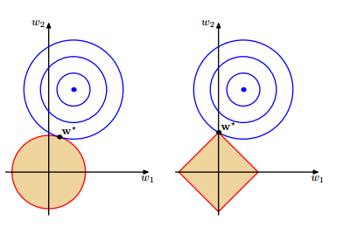

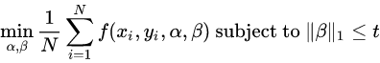
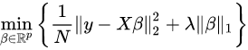
Classification
KNN: majority vote from K-nearest neighbors
Logistic regression: assume the log odds of event is linearly dependent on input. Lasso, Ridge and Elastic Net adds different regularization terms to objective function.
Bias-variance trade-off
which is Lasso?

Slide 7
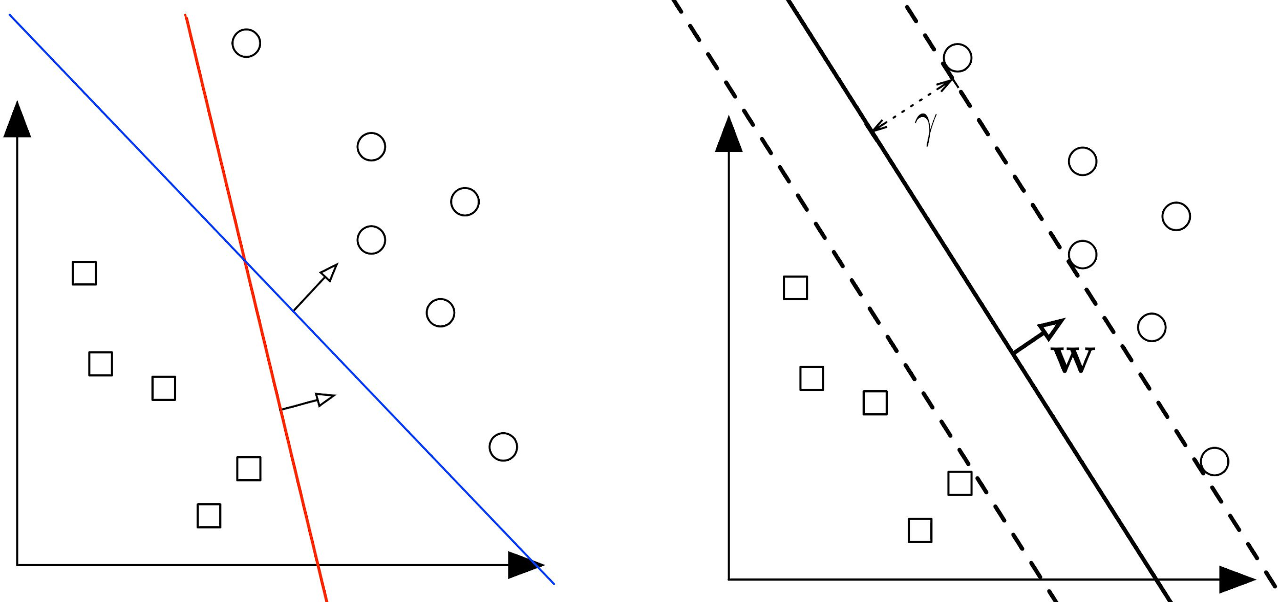
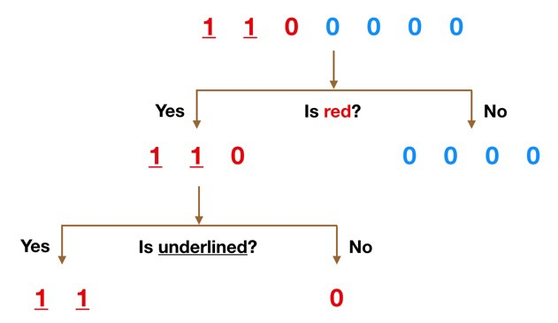
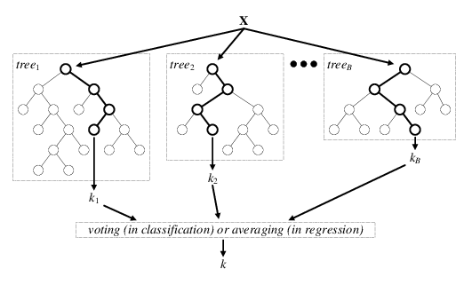
Classification
SVM: An SVM model is a representation of the examples as points in space, mapped so that the examples of the separate categories are divided by a clear gap that is as wide as possible.
Random forest: Ensemble method, A large number of relatively uncorrelated models (trees) operating as a committee will outperform any of the individual constituent models.

Slide 8
Caret R package: train + predict
The caret package (short for Classification And REgression Training) is a set of functions that attempt to streamline the process for creating predictive models. The package contains tools for:
data splitting
pre-processing
feature selection
model tuning using resampling
variable importance estimation
https://topepo.github.io/caret/model-training-and-tuning.html#an-example
# define control (cross validation)
control <- trainControl(method="cv",
number=5, savePredictions = TRUE,
classProbs = TRUE)
# the summary metric for selecting optimal mode
metric <- "Accuracy"
# kNN
set.seed(115)
fit.knn <- train(phenotype~.,
data=training, method="knn",
metric=metric, trControl=control)
# predict labels for new data
predict(fit.knn, newdata = head(testing))

Slide 9
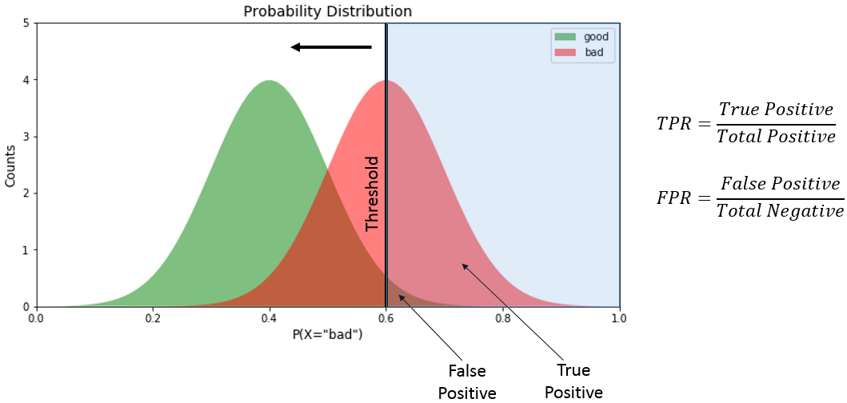
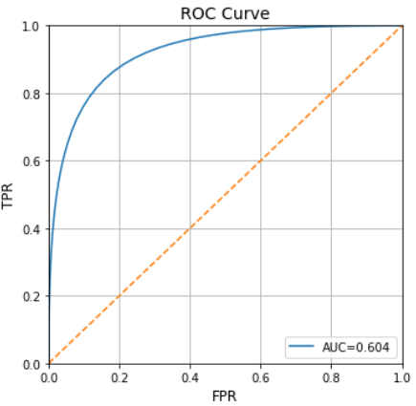
Caret R package: Model comparision
results <- resamples(
list(KNN=fit.knn,
Logistic=fit.logistic))
# where we compare accuracy & kappa
summary(results); dotplot(results)
# ROC curve
library(pROC)
rpartROC <- roc(true_labels,
predict_labels)
plot(rpartROC)
http://arogozhnikov.github.io/images/roc_curve.gif

Slide 10
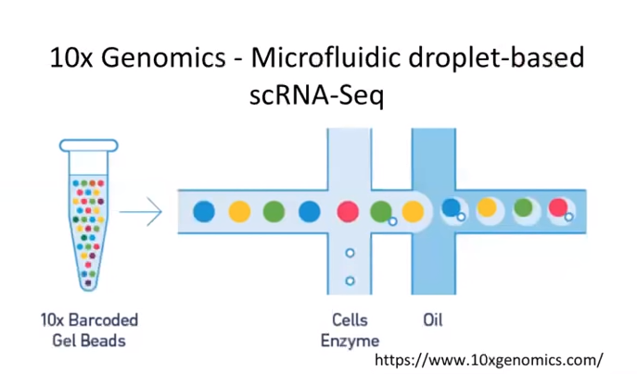
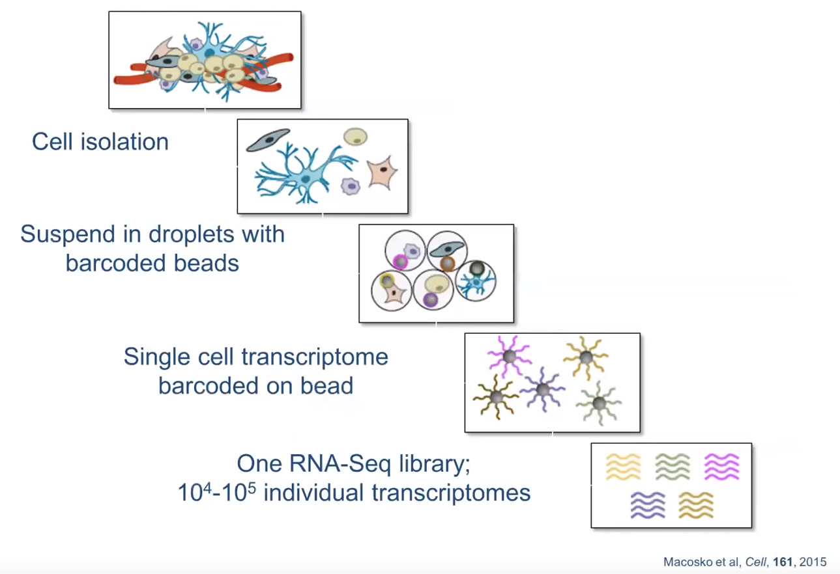
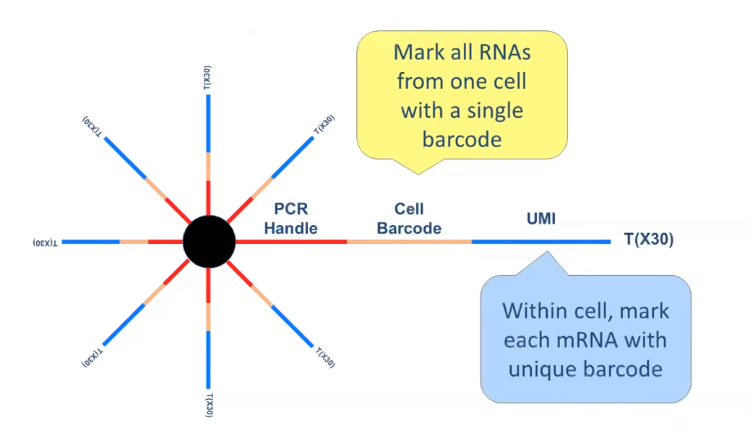
Recap: Single cell RNA seq
UMI: distinguish multiple copies of a transcript vs PCR artifacts

Slide 11
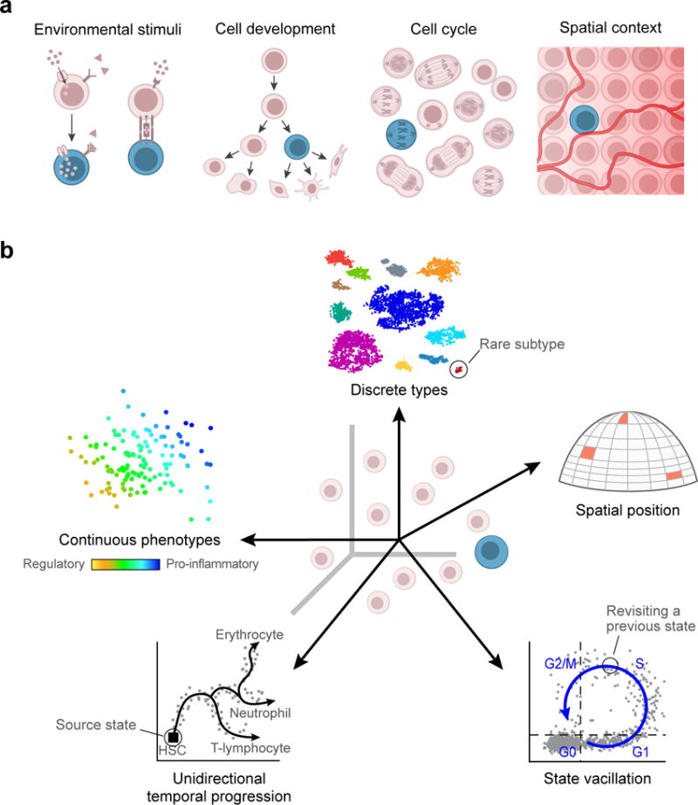
Biological insights in scRNA-seq
Characterize heterogeneity
Cell/gene clustering
Imputation of missing values
Cellular trajectories, differentiation
(Tumor) microenviroment
Wagner 2016

Slide 12
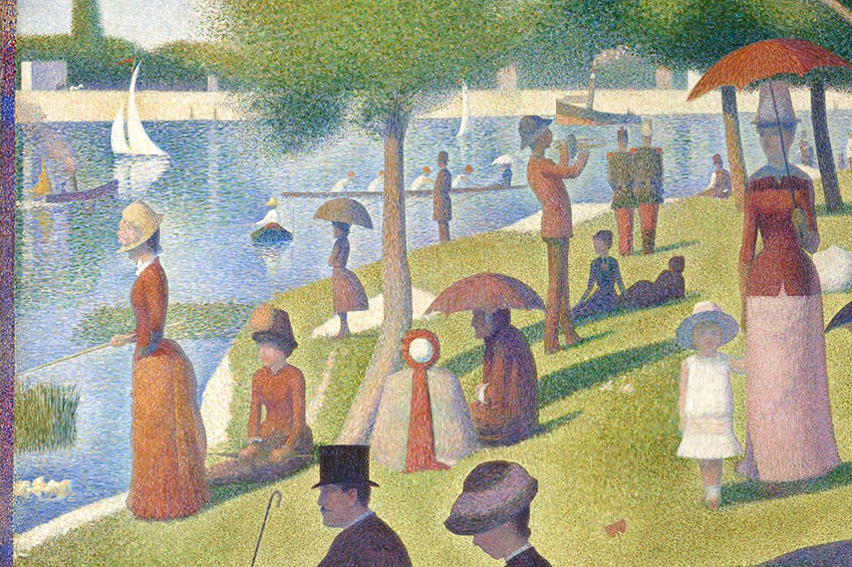
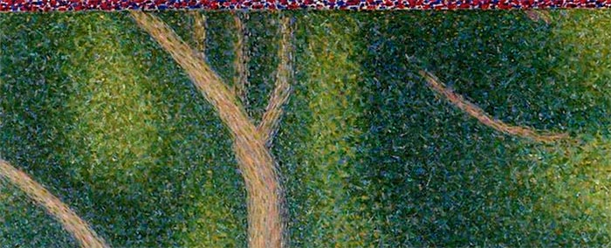
Seurat [v3]
https://satijalab.org/seurat/
R package for single cell analysis
Great vignette!
https://satijalab.org/seurat/v3.1/pbmc3k_tutorial.html

Slide 13
Seurat cheatsheet
pbmc.counts <- Read10X(data.dir = "~/Downloads/pbmc3k/filtered_gene_bc_matrices/hg19/")
pbmc <- CreateSeuratObject(counts = pbmc.counts)
pbmc <- NormalizeData(object = pbmc)
pbmc <- FindVariableFeatures(object = pbmc)
pbmc <- ScaleData(object = pbmc)
pbmc <- RunPCA(object = pbmc)
pbmc <- FindNeighbors(object = pbmc)
pbmc <- FindClusters(object = pbmc)
pbmc <- RunTSNE(object = pbmc)
DimPlot(object = pbmc, reduction = "tsne")

Slide 14
More links
(optional for students interested in bioconductor development) SummarizedExperiments: (Another) S4 object for experiment assays https://bioconductor.org/packages/release/bioc/vignettes/SummarizedExperiment/inst/doc/SummarizedExperiment.html
Seurat integration paper: https://www.cell.com/cell/fulltext/S0092-8674(19)30559-8
Bias-variance tradeoff https://towardsdatascience.com/understanding-the-bias-variance-tradeoff-165e6942b229
ggfortify::autoplot() for quick & nice PCA viz https://cran.r-project.org/web/packages/ggfortify/vignettes/plot_pca.html
UMAP, TSNE, PCA https://www.youtube.com/watch?v=nq6iPZVUxZU

